Slide 1
MONTGOMERY COUNTY REDEVELOPMENT COMMISSION ANNUAL MEETING
November 8, 2023

Slide 2
AGENDA
Welcome & Opening remarks
What / Who Is The RDC?
Economic Development & Communications Planning TS Update / Nucor Update
Capitol Expenditures
Water Infrastructure Expansion Update Wastewater Status
Current TIF Budget & Impact on Taxing Districts Q&A

Slide 3
WHAT IS THE RDC?
 The State Legislature allows counties to create Redevelopment Commissions (RDC) in order to carry out two very important tasks - the redevelopment of blighted areas and the promotion of economic development. The RDC's main job is to consider how it may use its authority to promote job creation. This primary responsibility is discharged through the creation of Economic Development Areas (EDAs) in order to facilitate economic development. The RDC must fully study current economic conditions, plan infrastructure and other projects designed to create jobs, and otherwise address economic development issues. In addition, the RDC is especially situated to finance such projects because of the statutory powers which allows for Tax Increment Financing (TIF).

Slide 4

WHO IS THE RDC?
The RDC consists of six (6) members. Five (5) members are appointed by the County Commissioners and County
Council. These 5 members are voting members. One member is recommended by a School Corporation, and this member is a non-voting member. The non-voting member has all of the same responsibilities of the other members.
2023 Board Members
Ron Dickerson, President Commissioner John Frey, Vice President
Rex Ryker, Secretary Councilman Gary Booth Phil Littell, Sr
Julie Hess - Non-Voting School Board Member Dan Taylor serves as counsel.
Auditor Mindy Byers, Treasurer

Slide 5
CONSULTANTS
Lochmueller Group
  Engineering Lead
BCS Management
  Wastewater Consultant
Peters Franklin LTD
  Financial Consultant
Taylor, Minnette, Schneider & Clutter
  Ongoing Legal and General Advice
Ice Miller LLP
  Legal Advice regarding Bonds and Ban Resolutions

Slide 6
ECONOMIC DEVELOPMENT & COMMUNICATIONS
Identify and coordinate resources
Decide Priorities and update as necessary
Develop and Refine a Capital Improvement Plan that identifies the County’s infrastructure importance within the TIF area.
Communicate with potential Investors interested in our community
Continue marketing Montgomery County with direction to residential and non-residential developers and be ready to take advantage of opportunities

Slide 7
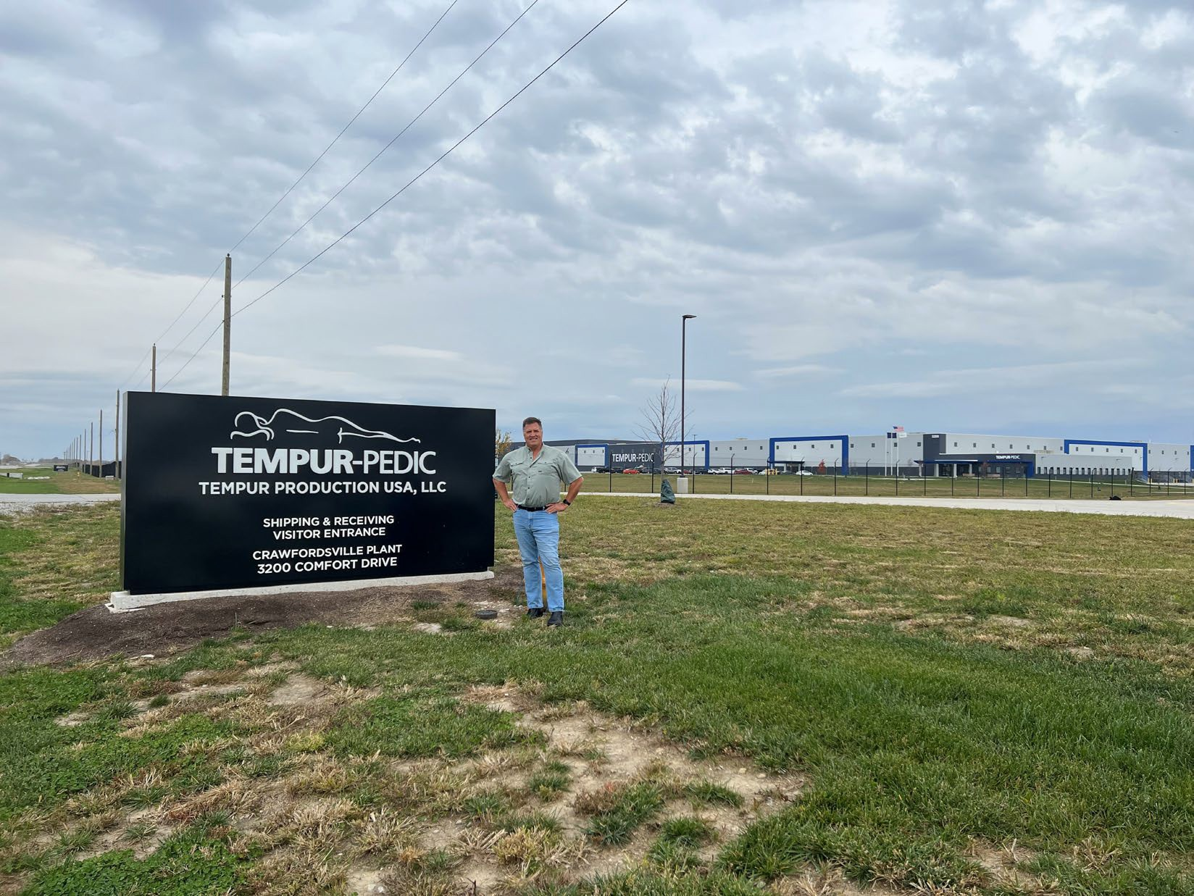
TEMPUR/SEALY $200 MILLION INVESTMENT IN OUR COMMUNITY

Slide 8
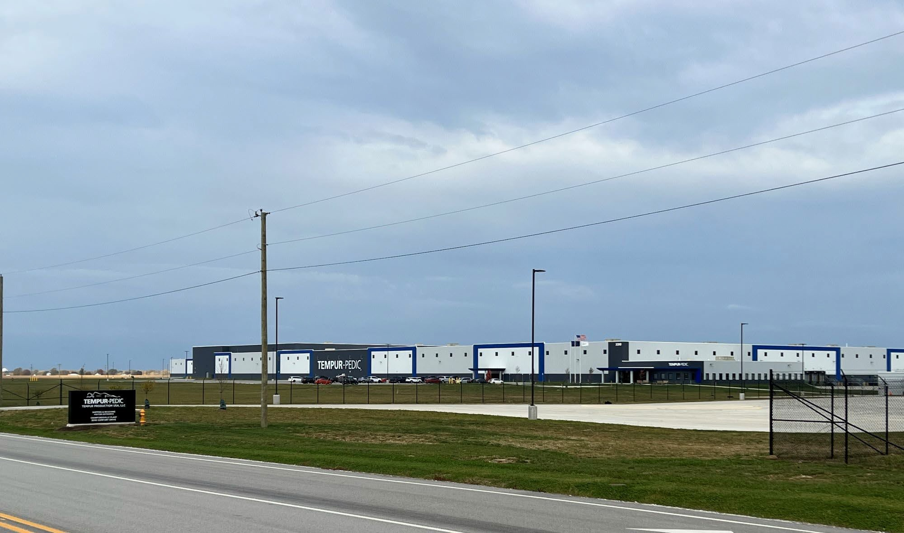

Slide 9
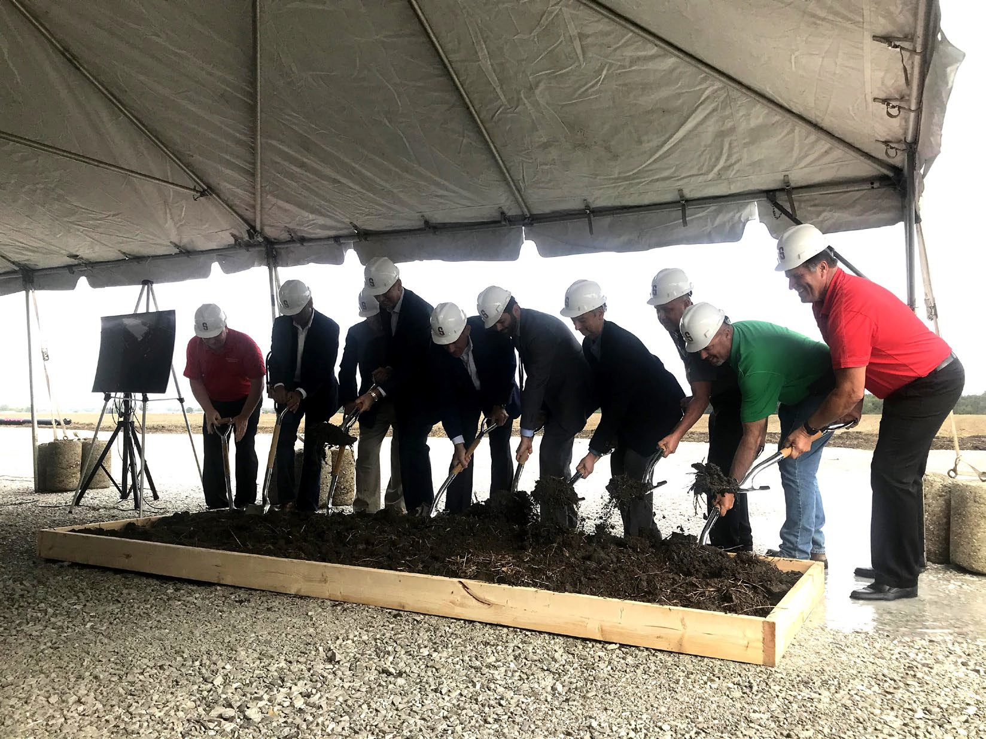
TEMPUR SEALY GROUND BREAKING CEREMONY
October 7, 2021

Slide 10
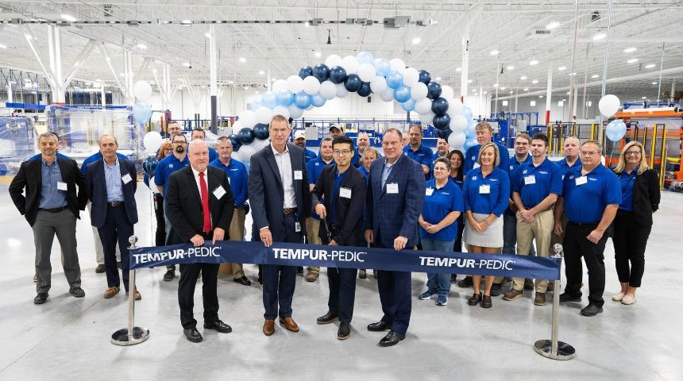
TEMPUR SEALY RIBBON CUTTING
October 4, 2023

Slide 11
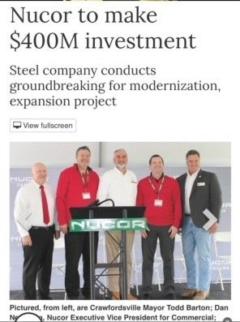

Slide 12
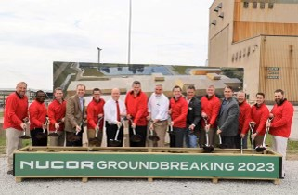
NUCOR STEEL COATINGS COMPLEX GROUNDBREAKING CEREMONY
APRIL 14, 2023

Slide 13
 Nucor Steel Sheet Mill Plant –
For construction grade continuous galvanizing line and pre-paint line.
80 employees
Expansion has begun with production projected to start in two years.
NUCOR CORRIDOR PLANNED FUTURE EXPANSIONS

Slide 14
 New facility to be located adjacent to existing Nucor Sheet Mill
 The new facility will be well equipped to provide a wide array of engineered utility structures necessary to support our nation’s electrification initiatives, such as grid hardening, renewable energy projects and building a nationwide network of EV charging stations.
 $115 million investment by Nucor
 200 Employees
 Construction expected to begin late 2023 to early 2024 with production expected to start by mid-2025.
NUCOR STEEL TOWERS AND STRUCTURE MANUFACTURING FACILITY

Slide 15
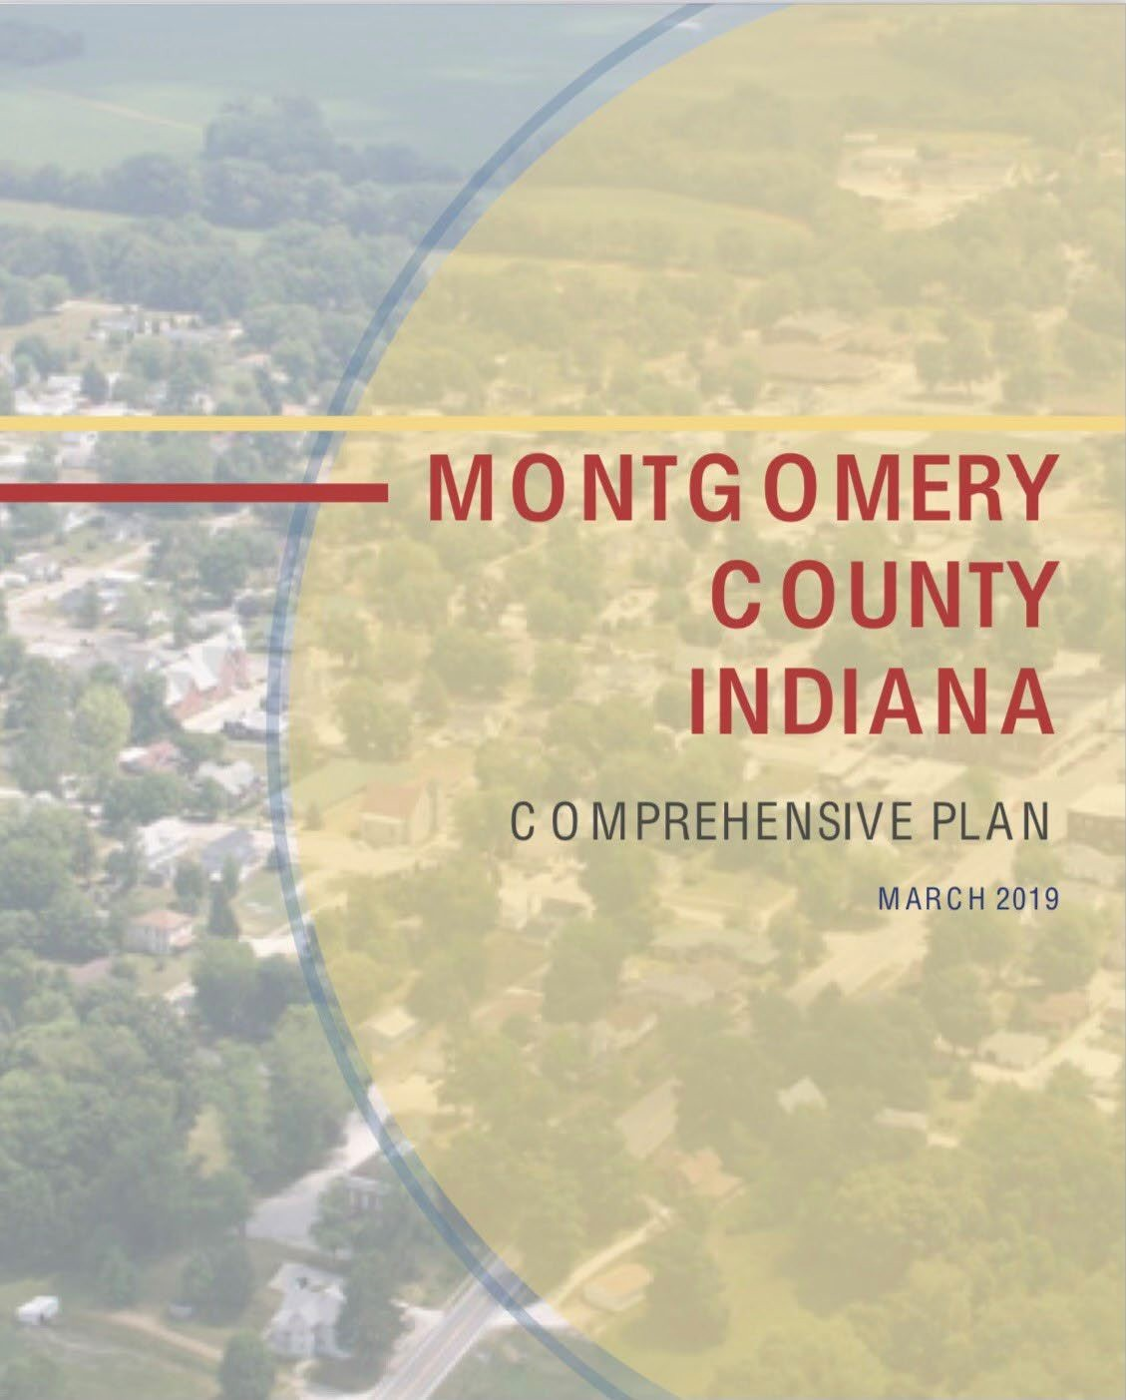
DEVELOPING A VISION FOR OUR COMMUNITY

Slide 16
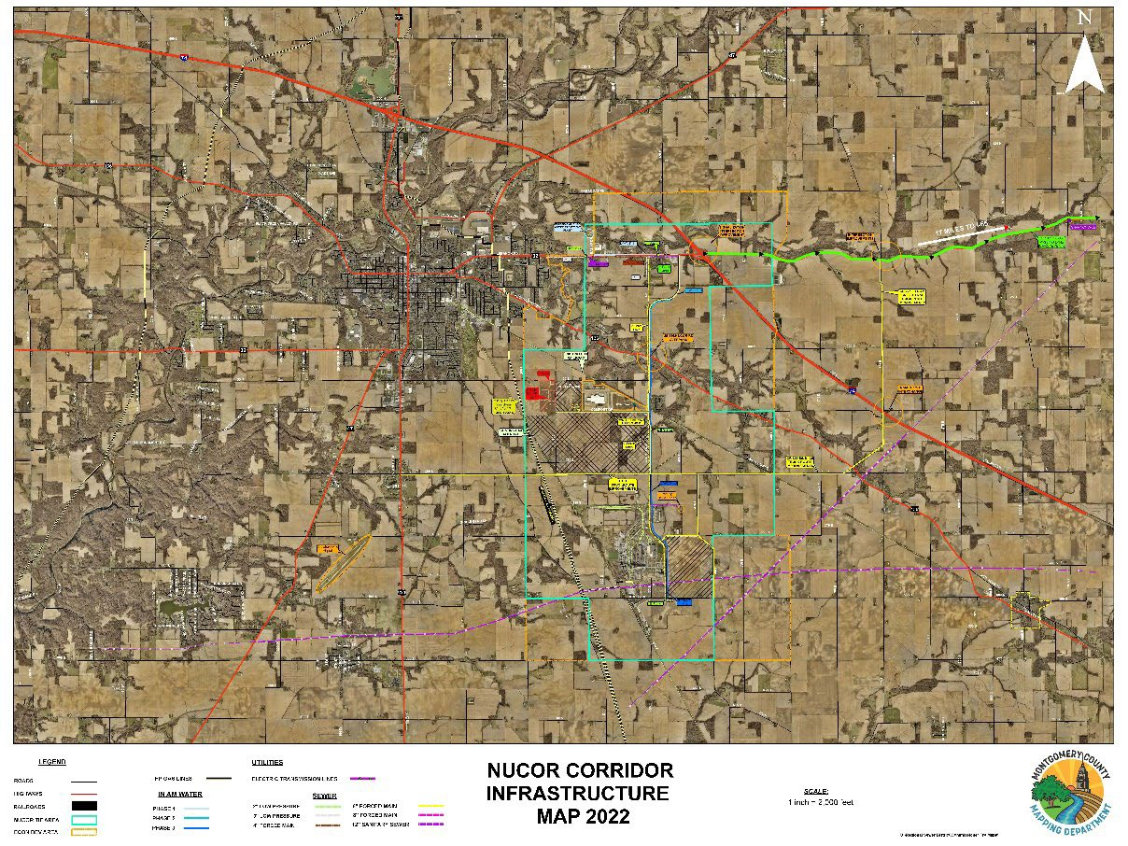
NUCOR CORRIDOR INFRASTRUCTURE MAP

Slide 17
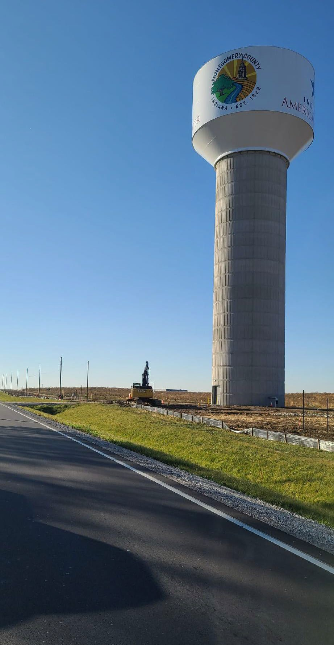
INAW WATER LINE EXTENSION
Purpose of Upgrades:
To extend the INAW’s service area into the TIF District. The New Water Main runs from SR 32 to Comfort Drive
Upgrade Consist of:
Approximately 4-Miles of New Water Main
Upgrades to Pumps at INAW Treatment Facility on SR 32.
New Elevated Storage Tank on Comfort Drive
Cost:
$15,677,000 Total
Grant:
$3,000,000 from SWIF

Slide 18
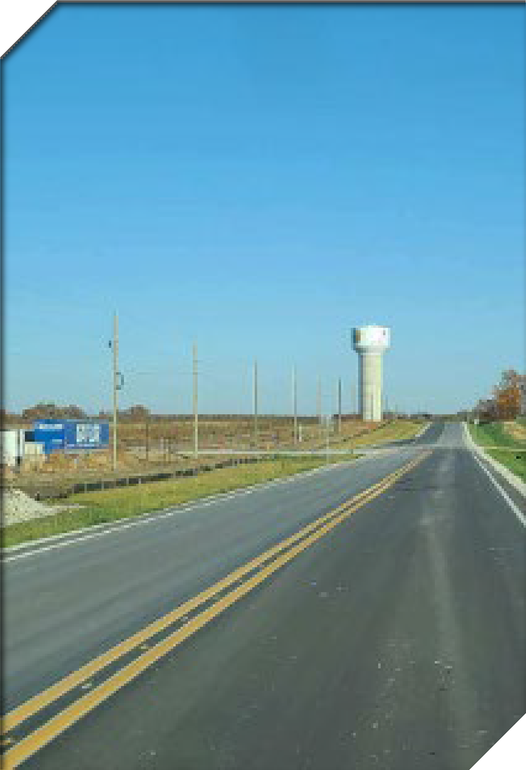
COMFORT DRIVE RECONSTRUCTION
Purpose of Upgrades:
To upgrade Comfort Drive (formally CR 200 S) from a narrow gravel road to 2-lane paved roadway. This upgrade will allow the increase of traffic and semi trucks to reach the Tempur Sealy Manufacturing Plant.
Upgrade Consist of:
Reconstruction of 1.5 Miles of Comfort Drive Consisting of:
Two 12’ Travel Lanes
2’ Paved Shoulders
Turn Lanes where Required
Drainage Ditches.
Utility Corridor For Utilities to Relocate While the Roadway Was Constructed.
Cost:
$3.6 Million

Slide 19
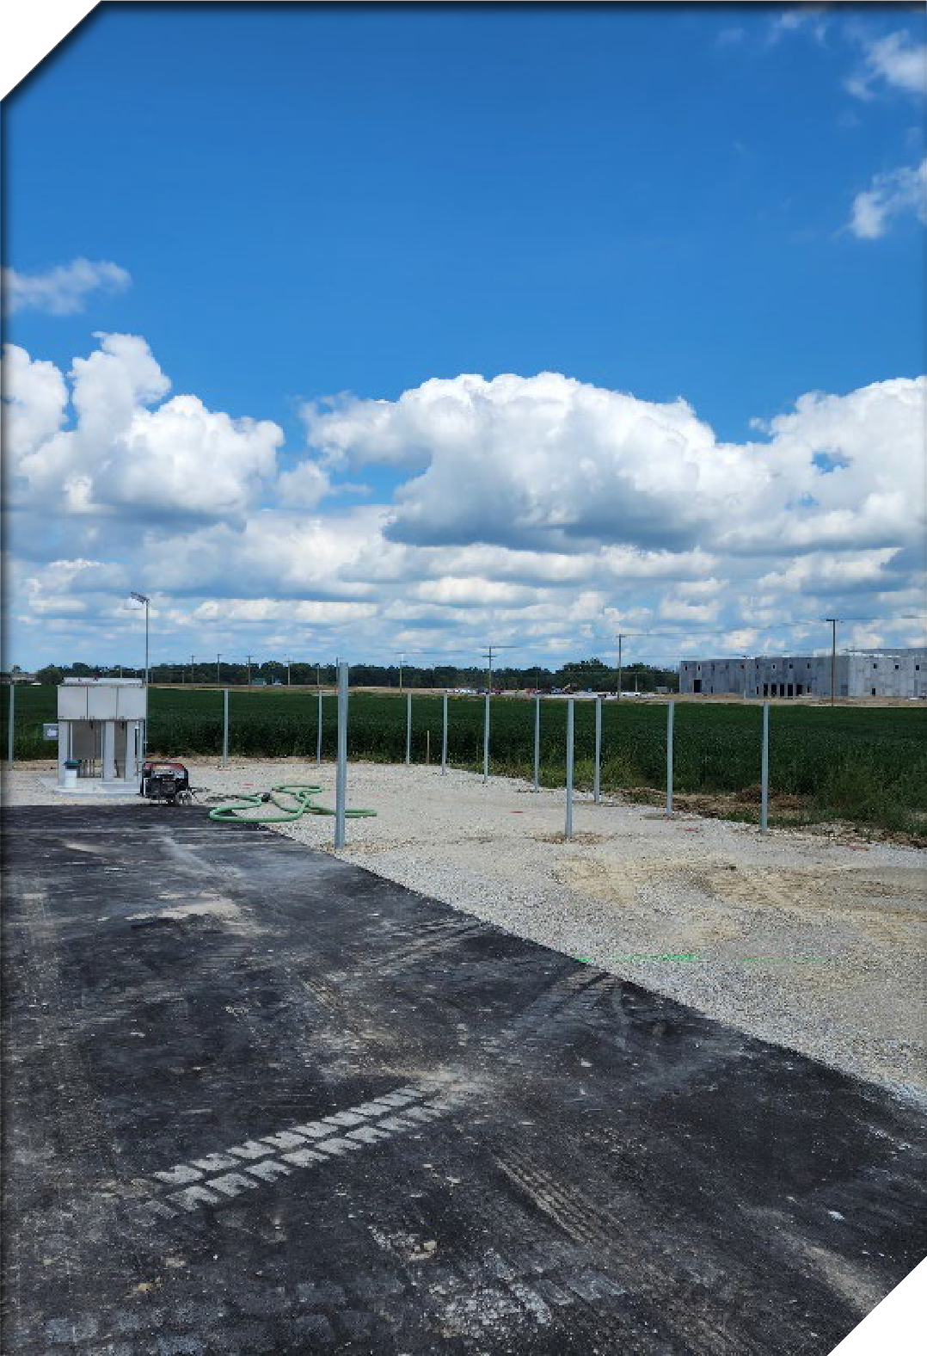
SANITARY SEWER EXTENSION
Purpose of Upgrades:
To extend the Regional Sewer District’s Sanitary Sewer capabilities down Comfort Drive.
Upgrade Consist of:
A New of Lift Station
4,225 Feet of Force Main
4,900 Feet of Gravity Sewer Main
Cost:
$1.1 Million

Slide 20

NON-TIF FUNDED RESIDENTIAL DEVELOPMENT
Develop CDC for land acquisition
Construct New Roadway & Utility Infrastructure
Utilize Residential TIF

Slide 21
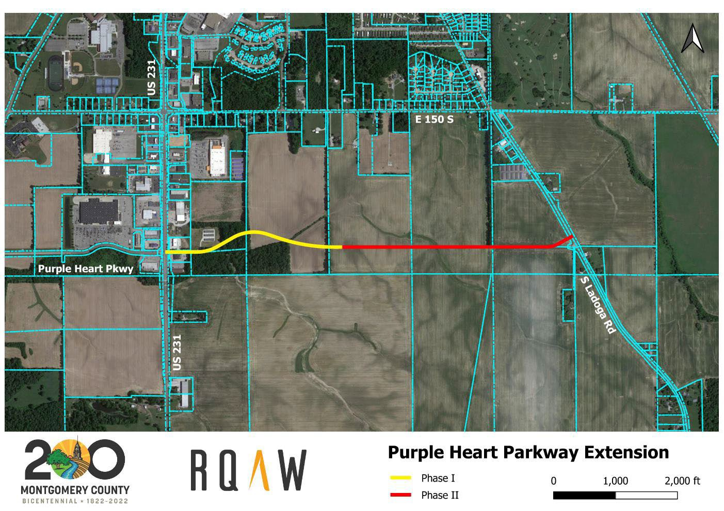
PURPLE HEART PARKWAY EXPANSION

Slide 22
FUTURE INVESTMENTS
Waste Water Treatment Plant Expansion
Extend Water Main on Nucor Road
Extend Sewer Line from SR32 along Nucor Road to 400E
 Connect Comfort Drive to Purple Heart Parkway
Extend 300S to connect Nucor Road to Ladoga Road
Connect Nucor Road to SR32 @ 775E (Truck Route)

Slide 23
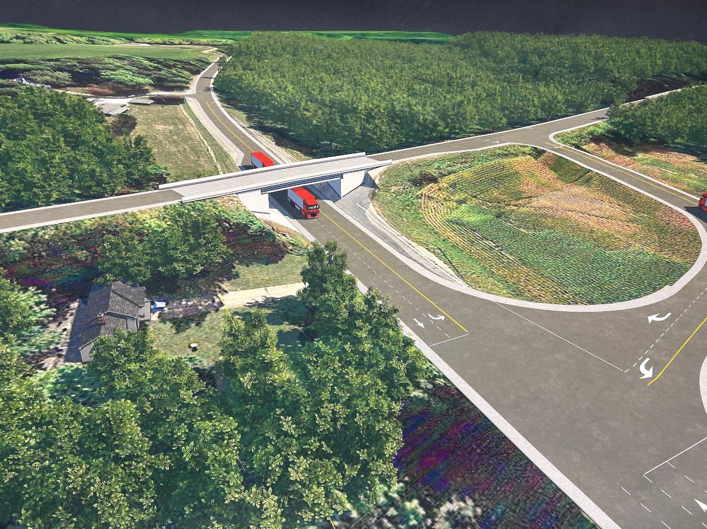
OVERPASS
NUCOR ROAD OVER US 136

Slide 24
 Overpass will eliminate the at grade crossing with US 136 and facilitate additional economic development in the Nucor Road area.
 Nucor Road serves the Nucor Sheet Mill and Tempur Sealy as well as other businesses.
 Estimated construction cost of $21.4 million
 RDC will apply for state funding with construction planned to begin in 2024 or 2025.
NUCOR ROAD OVERPASS

Slide 25
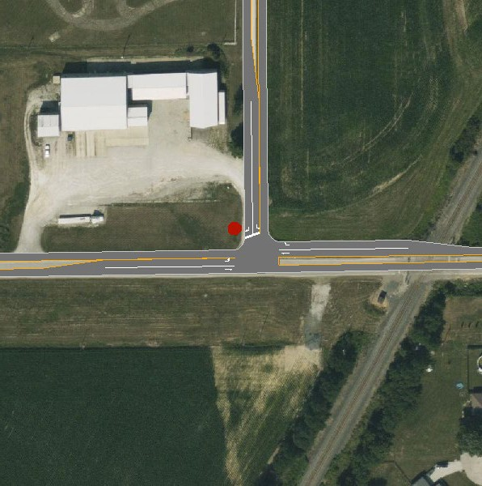
COMFORT DRIVE/NUCOR ROAD INFRASTRUCTURE UPGRADE

Slide 26
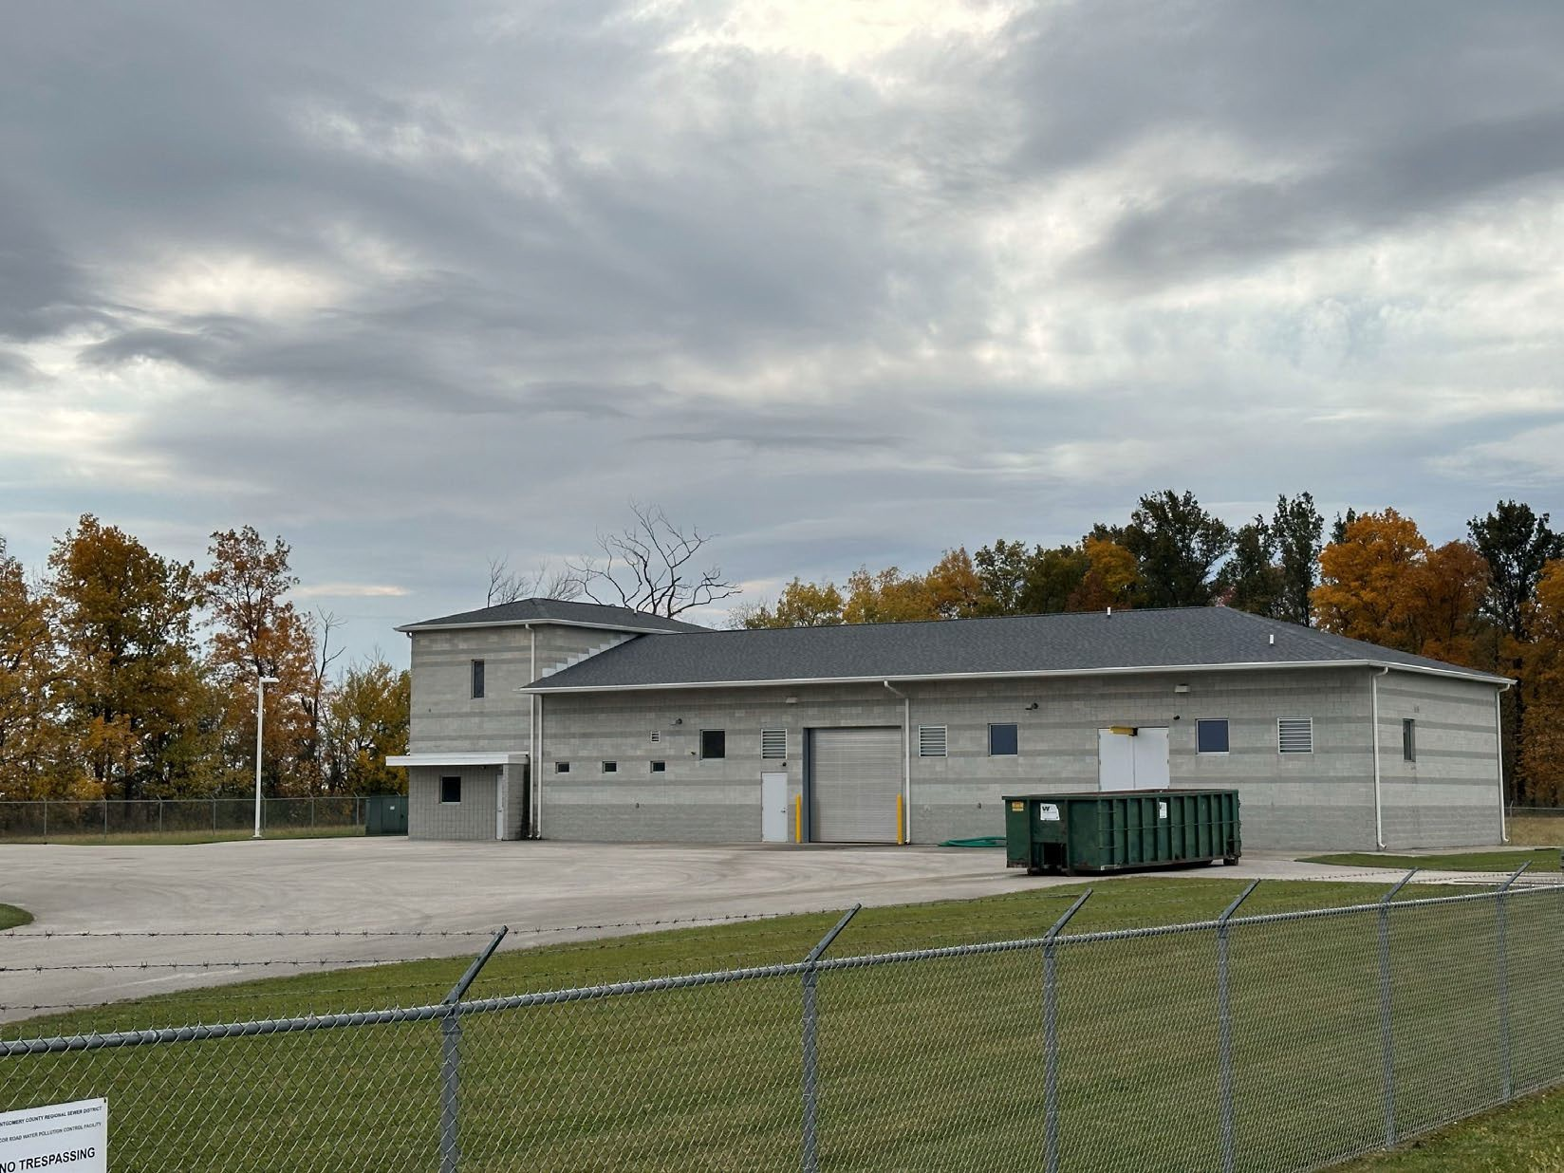
WASTEWATER TREATMENT PLANT EXPANSION

Slide 27
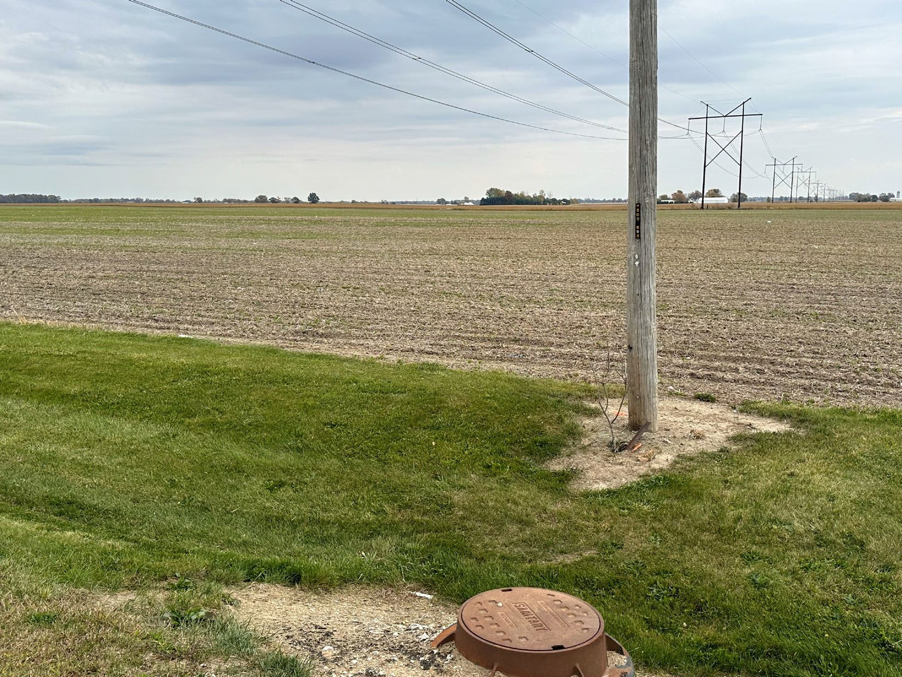
SHOVEL READY

Slide 28
CURRENT TIF BUDGET & IMPACT ON TAXING DISTRICTS
Jeff Peters Peters Franklin LTD

Slide 29

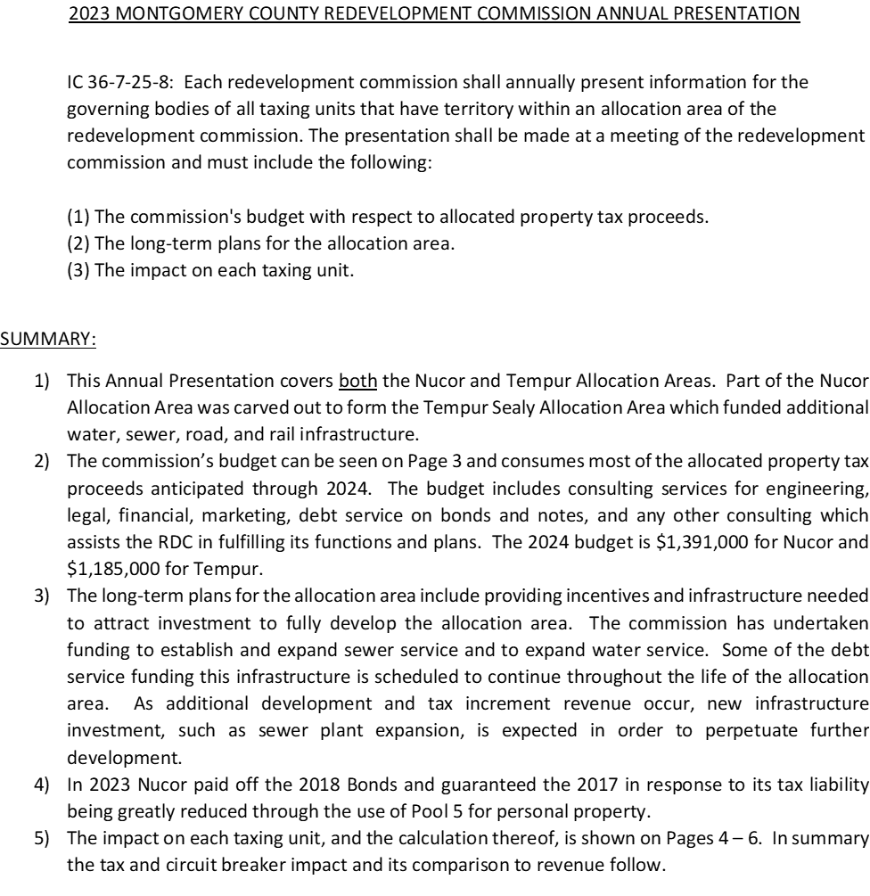

Slide 30

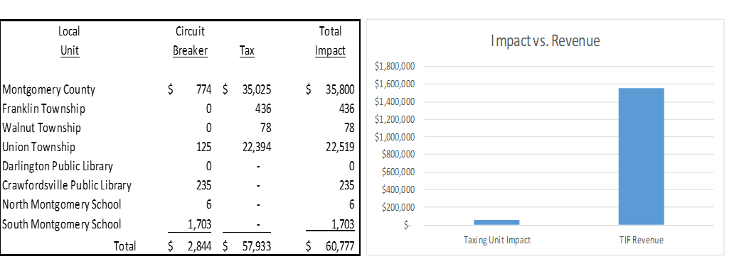
1) A common misconception is that if the TIF goes away, then all the TIF revenue flows back to the other local units of government. This is not the case. The most important take away is that for a very small annual tax and circuit breaker impact to the local taxing units ($60,777), the community annually harvests ($1,554,249) which has provided for the investment of tens of millions of dollars in infrastructure which should lead to substantial assessed value growth both inside and outside the allocation areas.

Slide 31

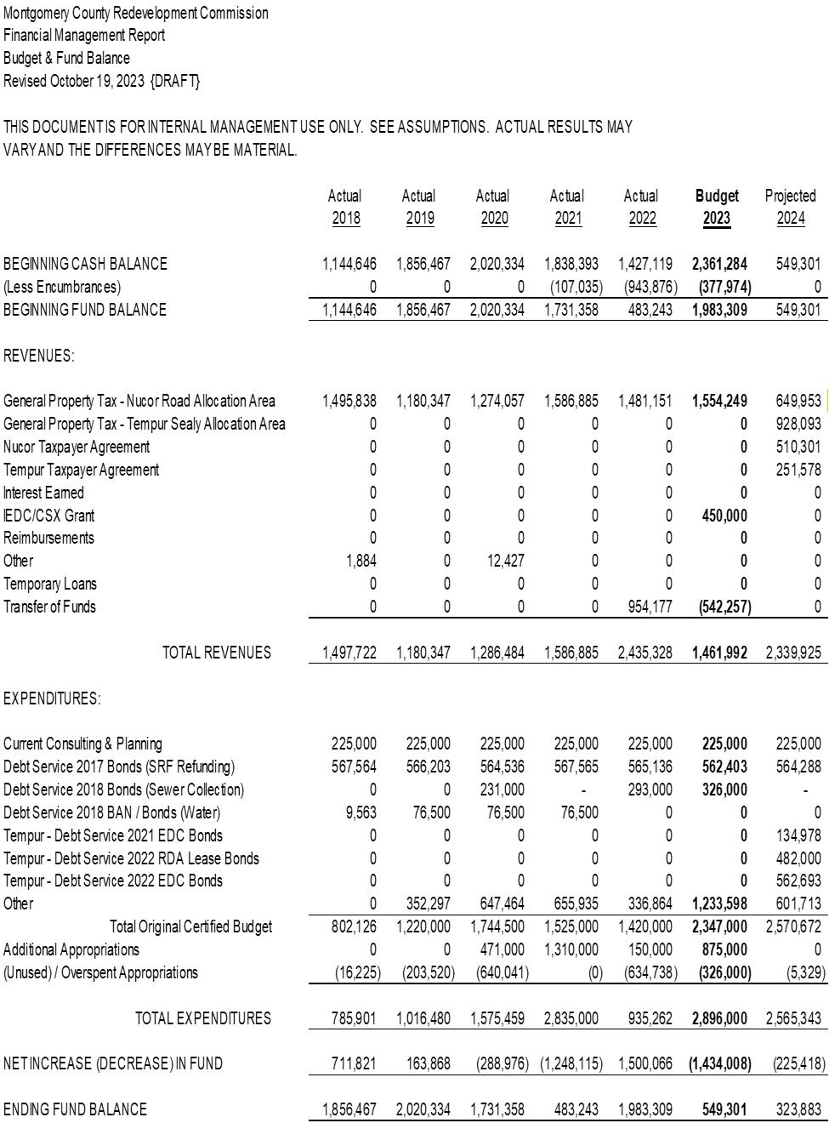

Slide 32

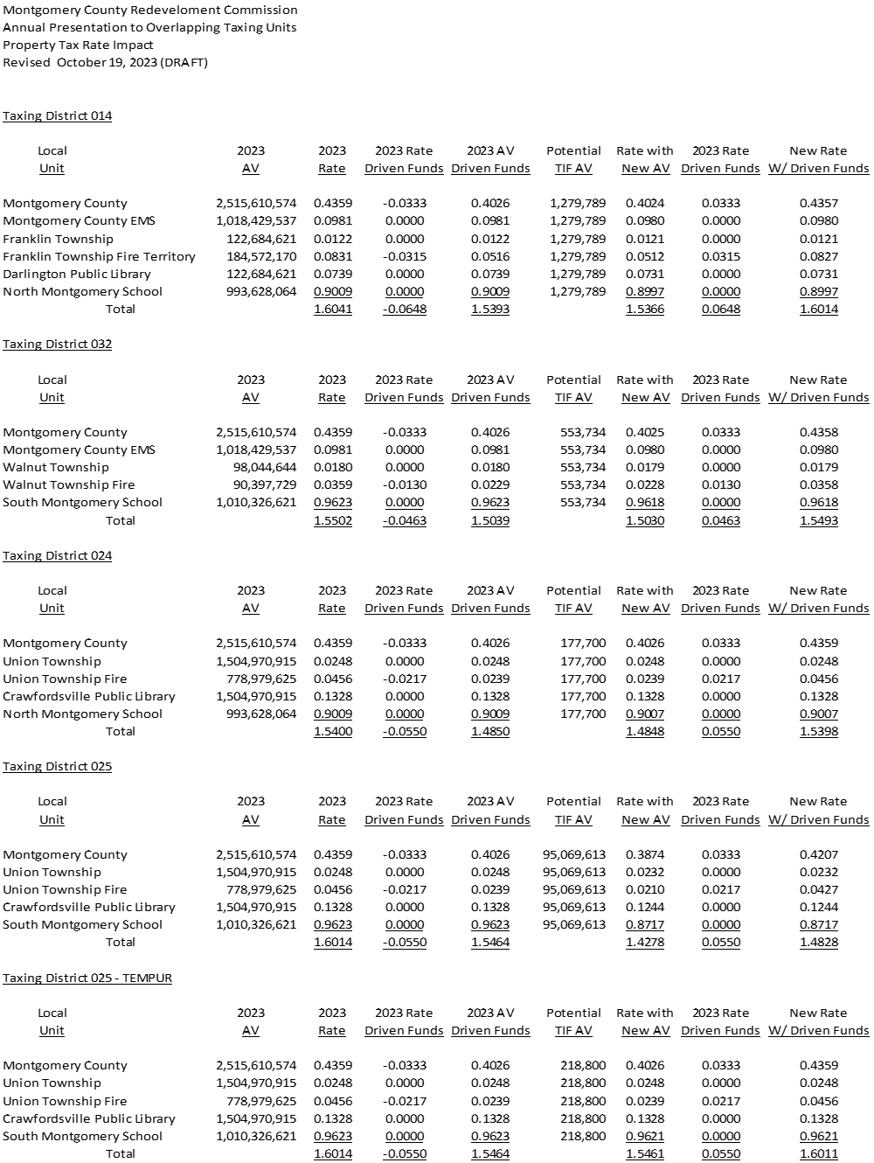

Slide 33

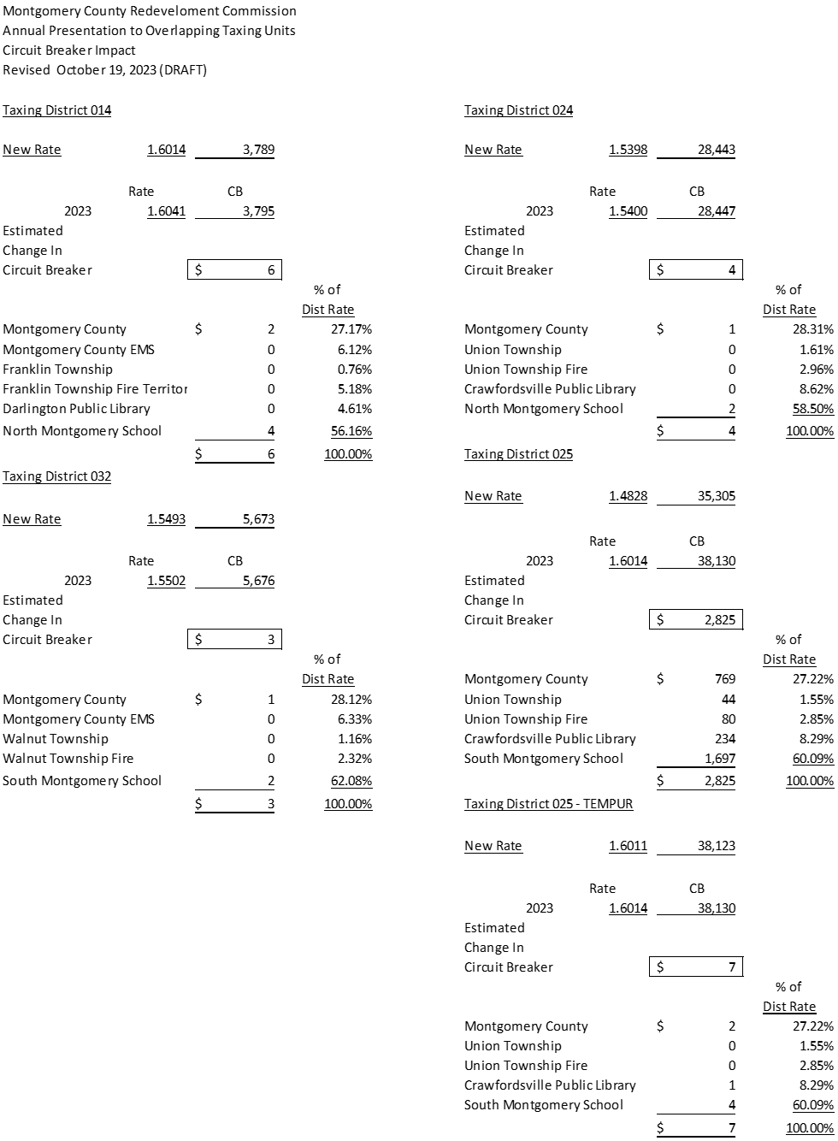

Slide 34

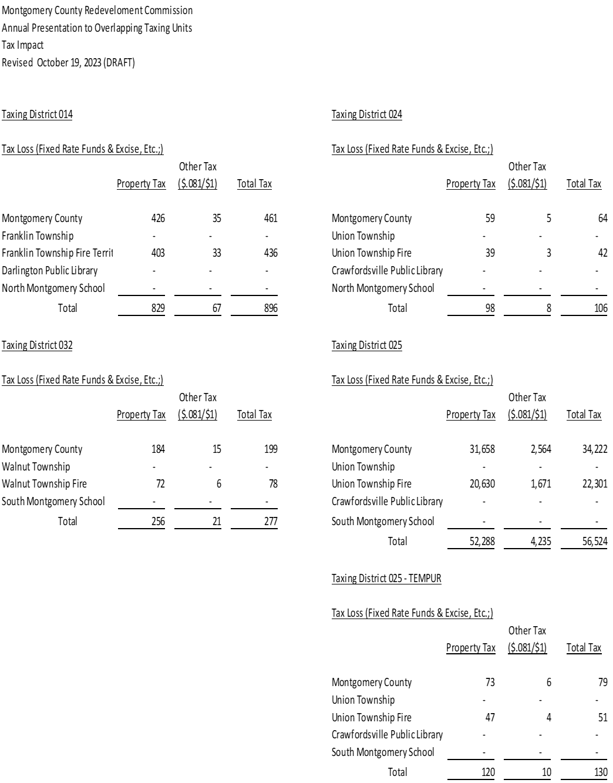

Slide 35
COMMENTARY & NOTES:
The RDC maintains a current budget document which quarterly looks at the current year budget to actual and also extends through 2024. Typically, the largest expenditures in the budgets are for debt service payments on the bonds outstanding and professional services toward the furtherance of the redevelopment plan. The payments for the sewer extension project include principal and interest which is scheduled to continue through the life of the allocation area. The extension of the sewer collection system may necessitate an expansion of the sewage treatment plant which may require the expenditure of cash reserves and or another bond issuance with repayment throughout the remaining life of the allocation area.
Part of the Nucor Allocation Area was carved out to form the Tempur Sealy Allocation Area which funded additional infrastructure for water, sewer, road, and rail infrastructure. Bonds have been issued to pay for this infrastructure and the repayment for these bonds are expected to come solely from the revenues generated from the Tempur Sealy Allocation Area.
The projects previously undertaken by the RDC support various commercial properties which contribute to the funding of the RDC. For pay 2023, the RDC is expected to have ~97,299,636 in assessed value designated as increment. The vast majority of that assessed value resides in taxing district 025 which impacts Montgomery County, Union Township, South Montgomery Schools and the Crawfordsville Library (see page 4). If the TIF were to expire with the current pay 2023 incremental assessed value, then that assessed value would fall back to the tax base. That increase in assessed value to the tax base would reduce some property tax rates (see page 4) which would in turn lower circuit breaker impacts (see page 5) and drive up the net collection of property tax. Other property tax rates could remain the same as they are statutorily regulated by rate and if those rates remained at their current levels, then tax revenue would increase (see page 6). Pages 4 – 6 show our estimated impacts of the incremental AV returning to the tax base.

Slide 36


QUESTIONS & WRAP-UP
Ron Dickerson Redevelopment Commission Board President

